Slide 1
Proposed Subdivision Review Regulation
Jasmine C. Kleiber, Wildlife Staff Specialist
Nevada Department of Wildlife – Technical Review Program

Slide 2
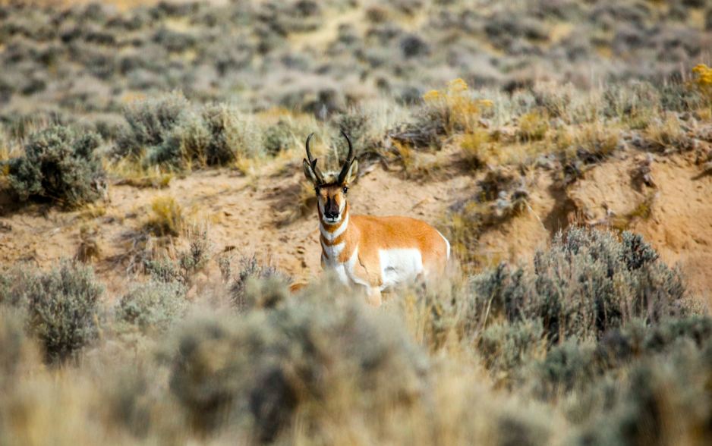
State of Nevada Assembly Bill 211 (2021)
2021 – AB211: Amending NRS 278
An Act relating to land use planning; requiring, with certain exceptions, a copy of the tentative map of the design of a proposed subdivision of land to be forwarded to the Department of Wildlife for review; revising the factors that are considered before taking final action on a tentative map; and providing other matters properly relating thereto.

Slide 3
Proposed Regulation (LCB File No. R162-22)
Relates to land use planning; specifically, subdivision development;
Defines and interprets several terms relating to the review of tentative subdivision maps;
Sets forth requirements of certain information to be submitted to the Department;
Provides that the Department will provide written comments on a tentative map;
Establishes certain fees for the review of a tentative map;
Provides for other matters related to review.

Slide 4
Proposed Regulation (Sections 1-6)
Definitions & Interpretations
Requirements of Developers
Definitions
“Subdivision”
“Tentative map”
Interpretations
“Infill Development”
“Substantially vacant”
“Vacant”
SUBMISSION OF:
Tentative map topographic features
location relative to nearest city/major highway
cross streets, or other landmarks
Expected timeline of development
Size of development (acres); Type of H₂O system to be used and H₂O source
map of 100-year floodplain; PLSS TRS of subdivision
Contact information
Master Plan indicating future development
Fee

Slide 5
Proposed Regulation (Sections 7-8)
Requirements of Department
Fees
Provide Written:
Notification of missing requirements (when applicable) in submission
Methods to avoid or minimize impacts to wildlife
Recommendations on mitigation measures (where appropriate)
Best Management Practices (BMPs) or Required Design Features (RDFs)
Notification that no impacts are anticipated (where applicable)
Development of a subdivision review form, available via Department website, to be submitted by Developers with tentative map and fee
Department will charge:
For initial review of tentative map:
$250 plus additional fee of $5 per acre shown on map
For review of any modifications to a tentative map previously submitted:
$5 per acre shown on modified tentative map

Slide 6
QUESTIONS?
Jasmine C. Kleiber
Wildlife Staff Specialist
Habitat Division
(775) 688-1561
jkleiber@ndow.org

